Slide 1
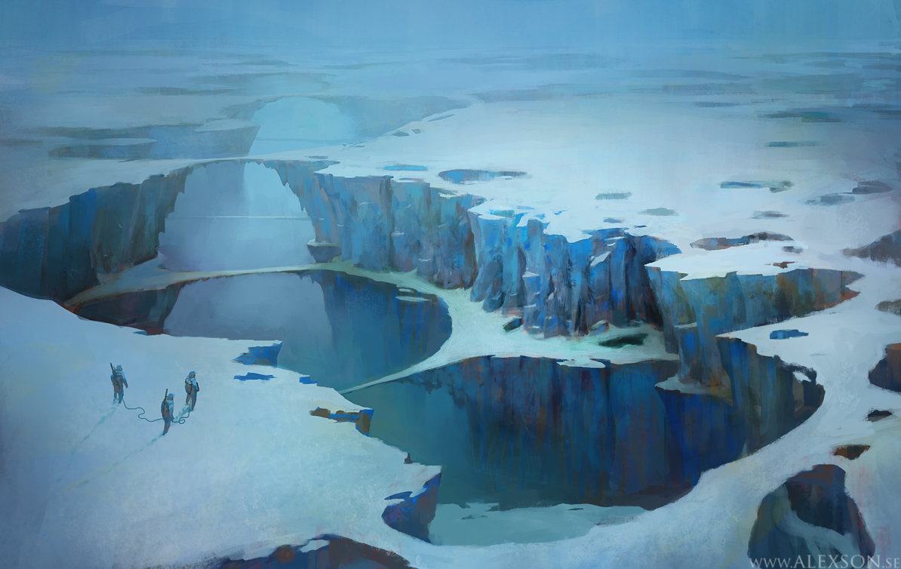
A World Apart
Presented by: Santa Hates Poor Kids

Slide 2
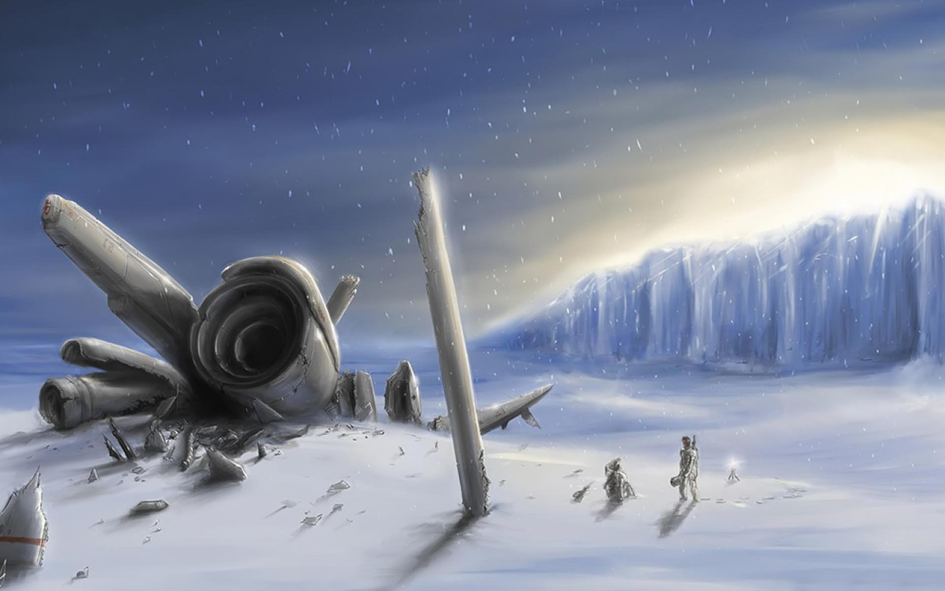
Crash Landing
Humanity’s last Hope…

Slide 3
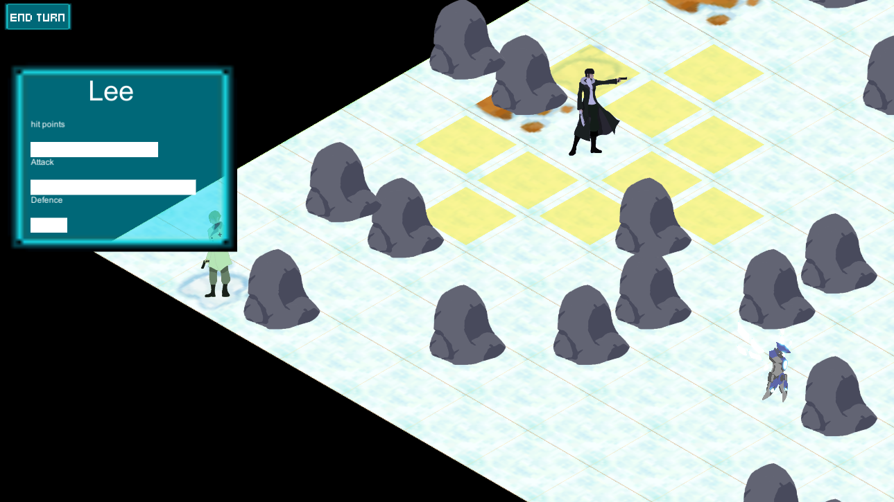
A World Apart
Procedurally Generated Turn Based Strategy
RPG mechanics, with collectable upgrades
Rich Story

Slide 4
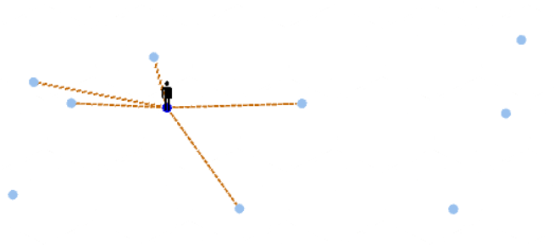
FTL meets Banner Saga
Follows Three Protagonists as they traverse a new world
Travel From Node to Node, meeting new people, finding out the mysteries of this new land
For all audiences, but catered to older demographics

Slide 5
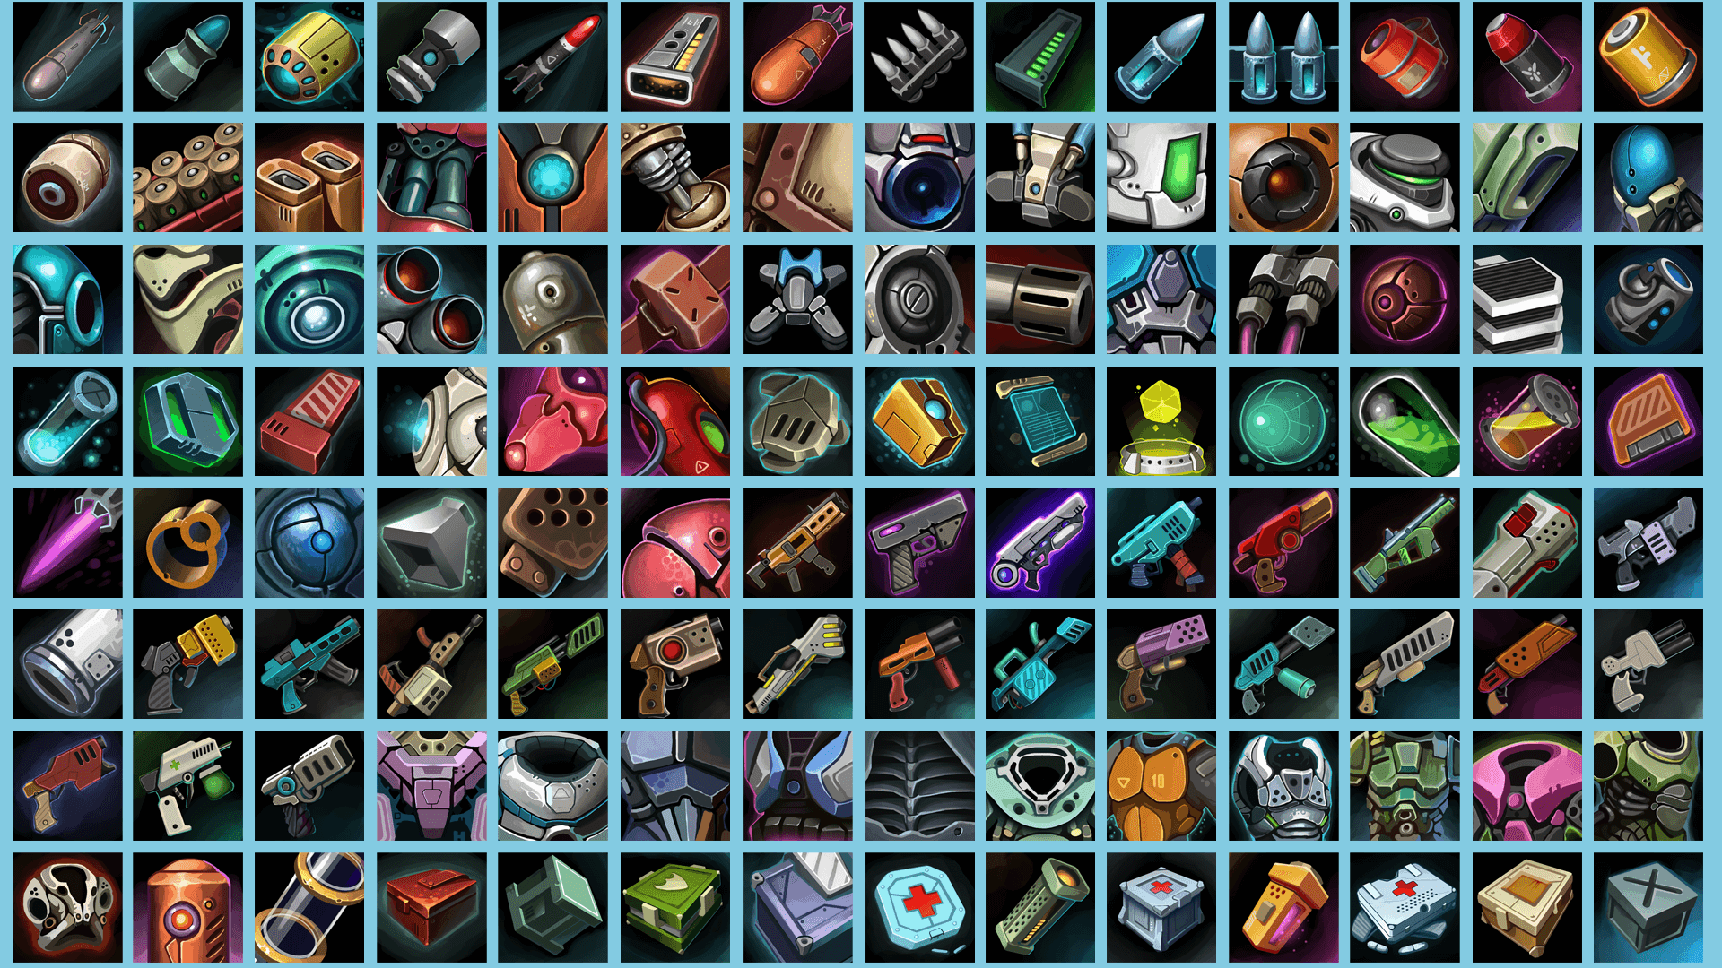
Why We’re Different
Choices that matter
Characters with story and development
Unique and Varied Item System

Slide 6

Demo

